Slide 1
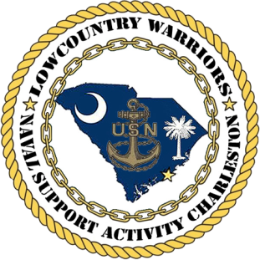
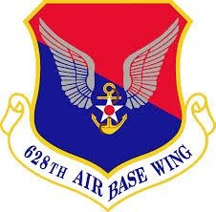
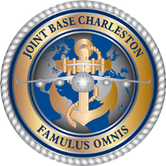
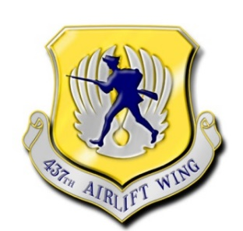
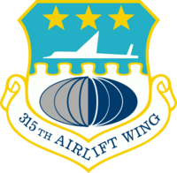
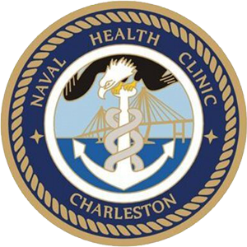
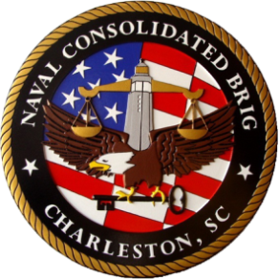
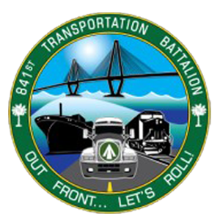
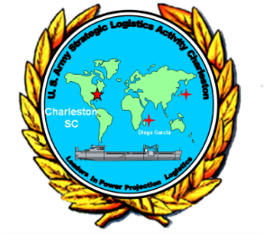
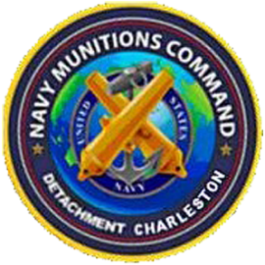
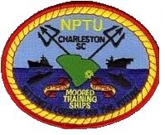
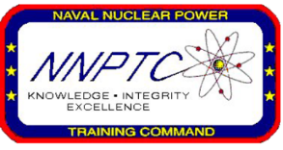
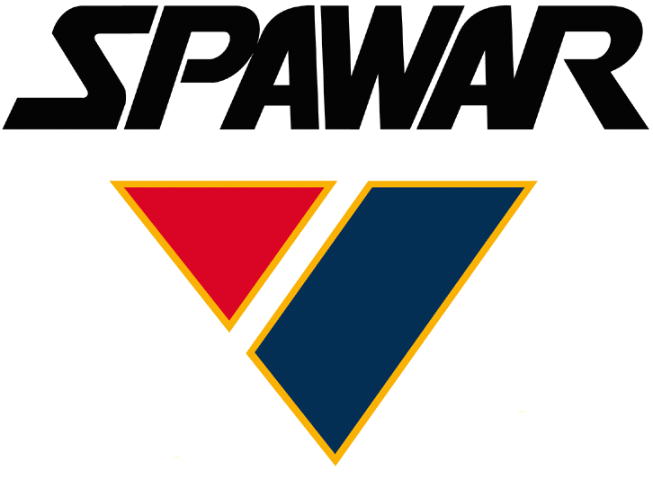
Welcome to
JB Charleston
23 Aug 2018

Slide 2
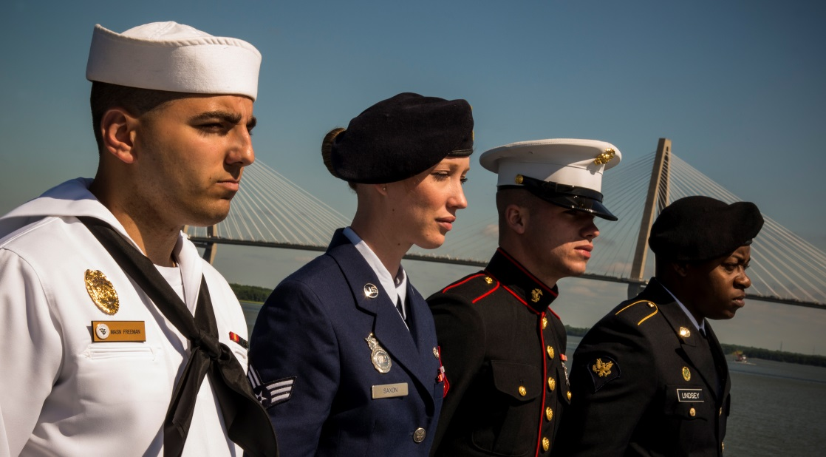
Who We Are
One of Department of Defense’s 12 Joint Bases
Consists of all U.S. military branches
Officially merged on
1 Oct 2010
Comprised of 628th Air Base Wing (Host)
and 60+ Mission Partners
Launch Point for the Nation’s Resolve
Notes:
Notes:
JB Charleston formed as a result of congressional legislation implementing the 2005 BRAC recommendations

Slide 3
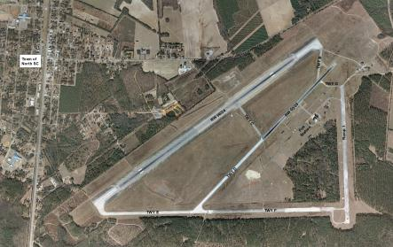
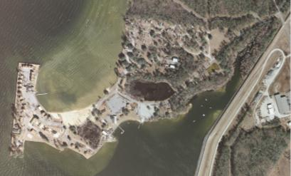
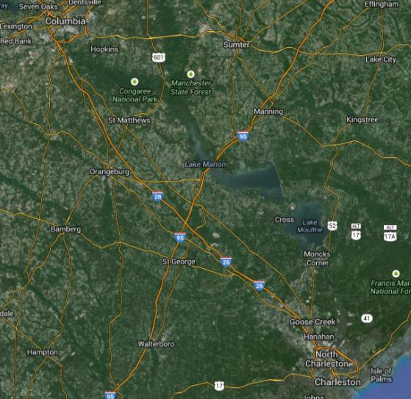
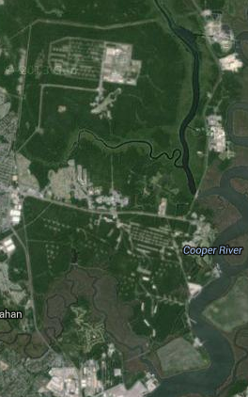
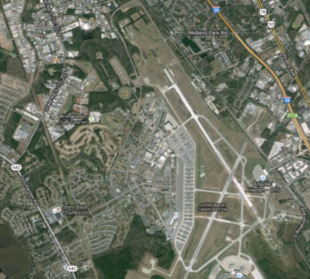
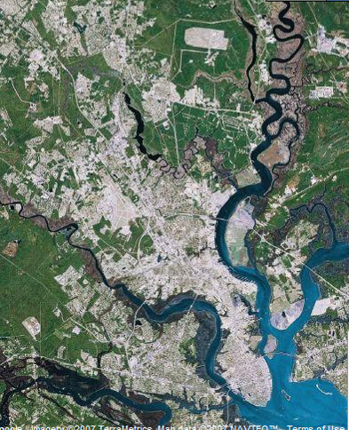
JB Charleston Scope
North Auxiliary Airfield
Supported Land and Personnel
Acreage: 23,777
Miles of Shoreline: 22
Total Population: 92,000
Short Stay Outdoor Rec Area
55 acres
Weapons Station
2,400+ acres
Air Base
3,400+ acres
17,000+ acres
Notes:
Notes:
Medium JB scope: 7th in land & people
Base Population:
Active Duty Military: 11,411
Reserves: 2,885
Gov Civilian Employees: 3,948
Contractors: 6,112
Dependents: 47,405
Retirees: 14,789
Grand Total: 92,000
Runways
Joint-use airfield, sharing two intersecting runways with Charleston International Airport
Primary runway is 9,001 feet long, and intersecting runway is 7,000 feet long

Slide 4

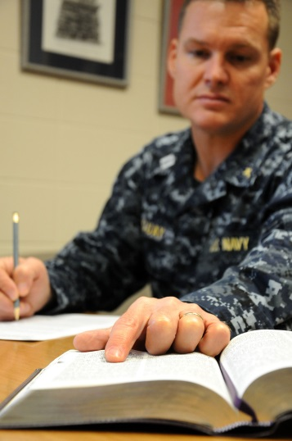
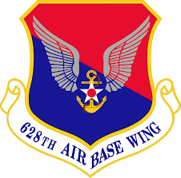
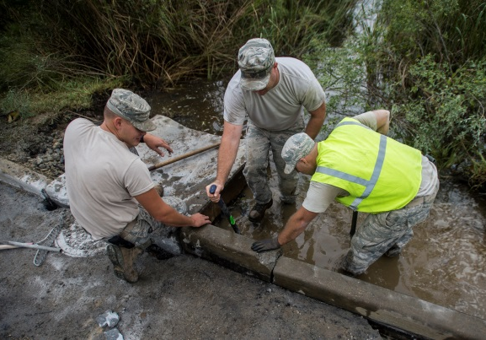
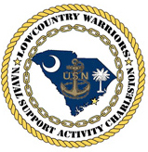
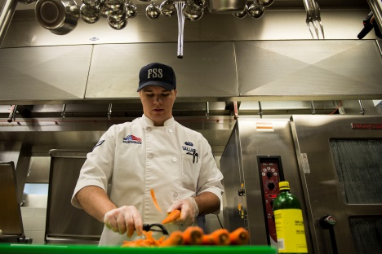
What We Do
Installation Support
628th Air Base Wing
Maintains base operating support services including facility maintenance, security, communications, and family services
Naval Support Activity
Provides logistical, technical, & material support, as well as joint coordination, to Fleet units and families
Notes:
Photos:
Top Left: A patrolman with SFS secures the flight line in Feb 2015
2nd From Left: Navy chaplain assigned to 628 ABW prepares for a Sunday sermon in Feb 2015
3rd From Left: Members of 628 CES work to fix road damage caused by floods in Oct 2015
Bottom Right: FSS Airman prepares food in the DFAC in Mar 2015
Notes:
- Provides installation support to more than 60 DoD & federal agencies serving over 90K military members, civilians, dependents, and retirees

Slide 5
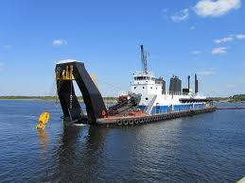
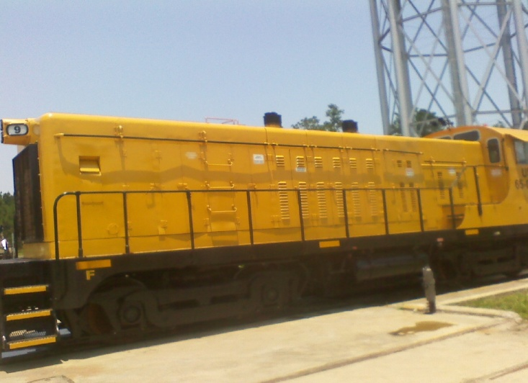
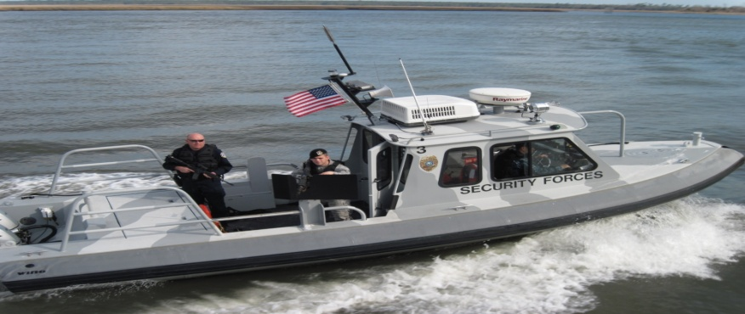
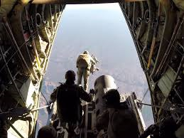
What We Do
Unique Installation Support
Missions
Cooper River Dredging
Supports fuel tankers serving Joint Base Charleston – required to maintain access channel depth.
Railcar Operations
Operates 3 locomotives supporting movement of crucial munitions, equipment, tanks, etc.
Harbor Security Patrol
Provides waterborne deterrence, detection and response to threats at Joint Base Charleston.
High Altitude Airdrop Mission Support (HAAMS)
Aerospace Physiologist experts assigned to ensure aircrew safety during special high altitude air drop missions. Only unit in the AF.

Slide 6
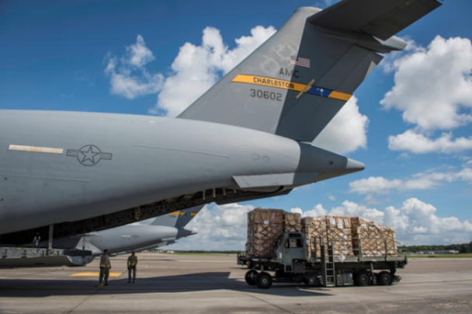
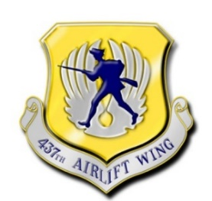
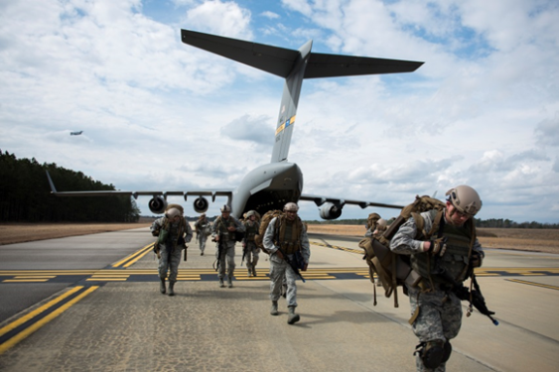
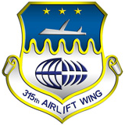
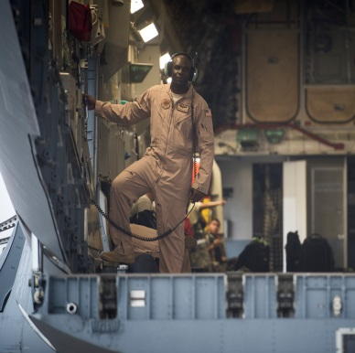
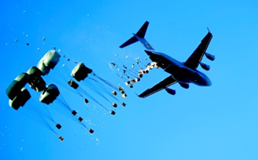
What We Do
Airlift & Airdrop
437th Airlift Wing
Executes Air Mobility Command’s Global Reach airlift capability via C-17 Globemaster III aircraft
315th Airlift Wing
Provides Reserve Airmen to augment airlift capabilities, and integrates with 437 AW in operations & logistics missions
Notes:
Photos:
Bottom Left: A loadmaster from 14 AS lowers the bay door of a C-17 in Oct 2015
Top: C-17 Globemaster from the 437 AW performs an airdrop during an exercise in April 2013
C-17 Globemaster III Fast Facts:
Crew consists of pilot, co-pilot, and loadmaster
Cruise speed of 518 mph at 28,000 feet
Max load of 170K pounds…can fit two large buses, three helicopters, or large Army tank
Can paradrop both cargo and 102 paratroopers
Is able to land on small, austere airfields – landing in as short as 3,000 feet

Slide 7
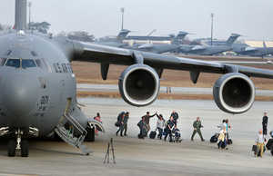
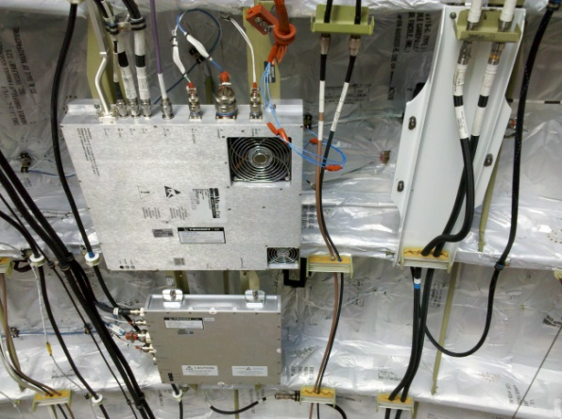
What We Do
437th Airlift Wing
Unique Missions
Special Operations Support (SOLL II)
The nation’s only C-17A Special Operations Low-Level support for Chairman of the Joint Chiefs of Staff-directed US Special Operations Command missions.
Special Airlift Flight (OGA)
Provides specially-certified aircrews for embassy support missions and support of upper level cabinet members.
Fixed Installation Satellite Antenna (FISA)
High-bandwidth satellite antenna system equipped on 23 JB Charleston aircraft to meet mission planning and Command & Control requirements.

Slide 8
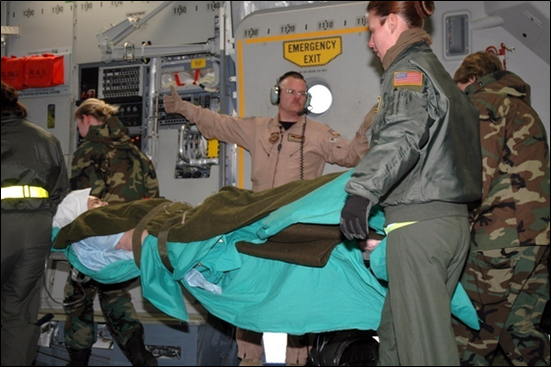
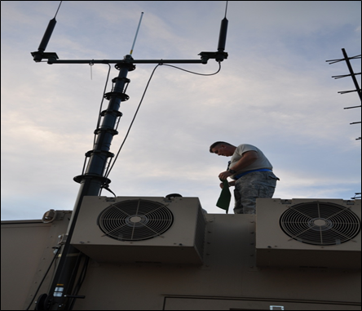
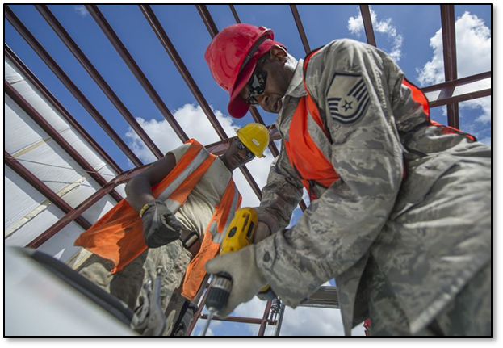
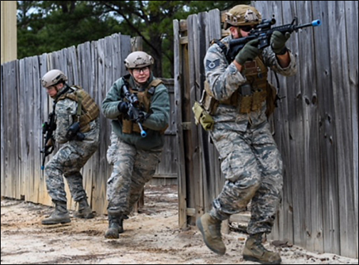
What We Do
315th Airlift Wing
Unique Missions
Aeromedical Evacuation
Trains crews to support combat forces during contingency operations, as well as humanitarian and peacekeeping efforts.
Contingency Response Flight
Maintains a force capable of deploying worldwide to any airfield with limited notice to set up mobile command.
560th REDHORSE Squadron
Provides commanders a dedicated, flexible airfield and base heavy construction and repair capability.
4th Combat Camera Squadron
The only Air Force Reserve Combat Camera unit in the Air Force.
Works closely with active duty Combat Camera under the Air force Public Affairs Agency (AFPAA)
9

Slide 9
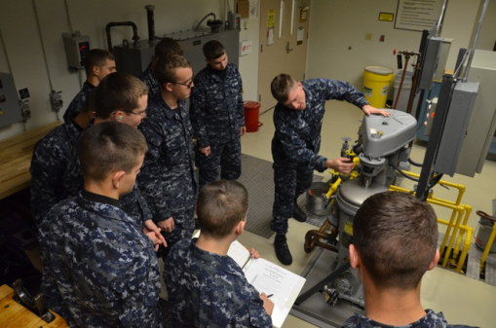
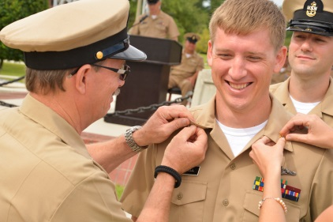
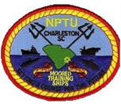
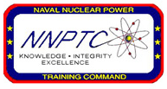
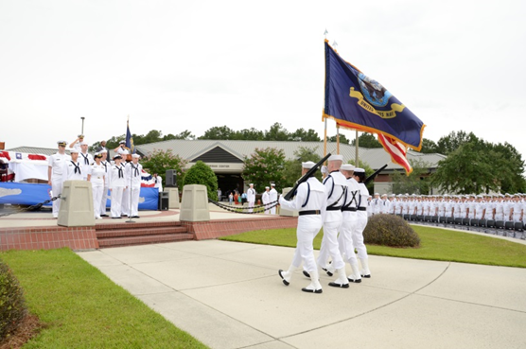
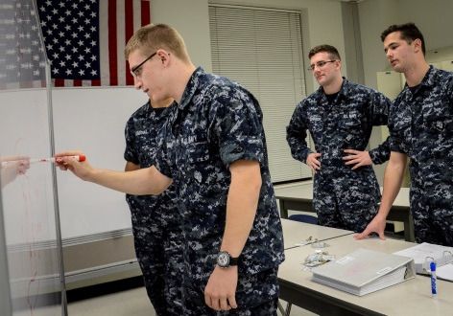
What We Do
Train Naval Nuclear Operators
Naval Nuclear Power Training Command (NNPTC)
Trains students in science and engineering fundamentals for design, operation and maintenance of nuclear propulsion plants
Nuclear Power Training Unit (NPTU)
Utilizes two moored submarines for hands-on training of nuclear propulsion plants
The Nucleus of the U.S. Navy’s Nuclear Power Training
Notes:
Photos:
Top Left: NNPTC students receive instruction during class in Feb 2015
Middle Left: NNPTC staff member is pinned and advanced to Chief Petty Officer at the FY16 Chief Pinning Ceremony
Middle Right: NNPTC’s Color Guard presents the Colors during NNPTC’s graduation ceremony in April 2011
Bottom Right: NNPTC students study for an upcoming exam in Feb 2015
Notes:
Consists of Nuclear Field “A” School (rate-specific training) and Nuclear Power School (6-month course focusing on nuclear theory & fundamentals)
JB CHS trains & certifies half of the nation’s nuclear fleet (the other half is trained at NPTU Ballston Spa in NY)
JBC will train 2/3 of all nuclear fleet once Ballston Spa shuts down one of its reactors in 2018
When NNPTC campus is fully manned, it hosts over 3,600 students and 480 staff members

Slide 10
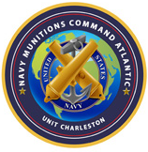
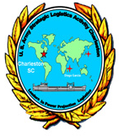
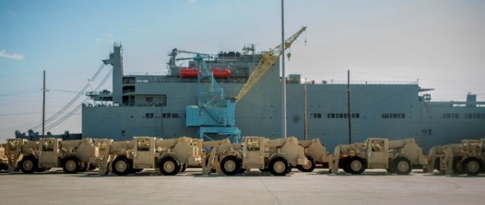




What We Do
Deployable Logistics
841st Transportation Battalion
Performs water terminal operations for DoD cargo, to include port clearance, load, and unload.
Navy Munitions Command
Army Field Support Battalion Charleston (AFSBn-CHS)
Maintains, inspects, & handles stock of underwater mines and ordnance
Provides rapid global support to war fighters as part of Army Prepositioned Stock Program
Notes:
Photos:
Top Left: Navy Munitions Command sailor works on a mine during an exercise in July 2014
Top Middle: 841st TB preparing to load Army vehicles onto the USNS Watkins at JBC in Dec 2014
Bottom Middle: Navy Munitions Command sailor works on a mine during an exercise in July 2014
Top Right: Railcar with tanks being loaded by 841st TB in Sep 2013
Notes:
841st TB performs water terminal operations for all DoD cargo on commercial vessels from the port of Savannah, GA to Maine along the Atlantic coast. This includes conducting documentation support, conduct port clearance, and load/unload cargo
Capability to offload up to 150 trucks and 200 railcars of cargo per day
Navy Munitions Command receives, stores, and issues Navy & Marine Corps ordnance throughout the Fleet
ASLAC performs maintenance on Army equipment pre-positioned on ships throughout the world, reducing deployment response time
Pre-positioned ships typically have 393K sq ft of storage space which can carry up to 2.3K containers of kits and ammunition
Each ship is capable of storing everything needed to supply a brigade-sized combat team…from armored vehicles to MREs

Slide 11






What We Do
Multi-Mission Warfighter Support
Naval Health Clinic Charleston
Naval Consolidated Brig
Delivers health care and specialty services including pharmacy, radiology, pediatrics, & mental health
Ensures security, discipline and safety of United States military prisoners
Space and Naval Warfare Systems Center (SPAWAR)
Designs cyber networks for communications, computers, and space systems
Notes:
Photos:
Bottom Left: NHCC healthcare provider conducts physical therapy appointment in July 2013
Top: SPAWAR Executive Director commemorates the integration of the electronic systems into more than 27K MRAPs through the SPAWAR Integration Facility in a ceremony in Dec 2012
Bottom Right: Aerial view of the Navy Consolidated Brig
Notes:
SPAWAR develops, delivers, & sustains communications & information capabilities for warfighters
Most of it’s work is classified
Example of a non-classified project: SPAWAR Internet Café program, which supports satellite connectivity for approximately 10K computers & 4K telephones to provide a variety of communication devices while overseas.
Naval Brig has 400 cells and can hold 288 inmates

Slide 12












What We Do
Interagency Cooperation
U.S. Coast Guard Sector Charleston
U.S. Army & Marine Corps Reserve Training Centers
U.S. Coast Guard Maritime Law Enforcement Training Center
U.S. Coast Guard Base Charleston
Reserve Navy Operational Support Center
USCGC Hamilton
Ralph H. Johnson Veteran Affairs Medical Center
USCGC James
Federal Law Enforcement Training Center (FLETC)
U.S. Army Corps of Engineers Charleston District

Slide 13





Mission Accomplishments
Air Force Honorable Mention & AMC Winner 2018 Commander in Chief’s Installation Excellence Award
628th Air Base Wing: Air Force Outstanding Unit Award win
437th Airlift Wing Meritorious Unit Award
AMC’s Busiest Airlift Program 16.5K sorties/9K missions
Supported Army’s busiest port—8M pounds of equipment processed
Maintained $3.2B infrastructure—24K acres, 1.8K bldgs, 4 runways, 2 wharfs, 5 piers, 34 miles of rail
Notes:
Enabled 16.5K sorties and 6K missions–Most flying hours in the AF!
Fused Navy/VA/AF clinics sharing 336 referrals saving $725K
Executed 17 local Unexploded ordinance missions
Mx’d $3.2B PRV/24K acres/1.8 bldgs/4 rwys/ 2 wharfs/5 piers/34 mi of rail
AMC’s 1st fixed X-ray contract–scanned 71K vehicles/located 300 threats
AF first Transportation Isolation System in response to Ebola outbreak

Slide 14


Mission Accomplishments
Naval Munitions Command aced Mine Readiness Certification—98.4% weapon reliability rating
7 USCG Cutter munitions uploads/1st-time ever; disposal of 16Klbs/$240M captured drugs
Air Force test bed for DHA transition
Issued 35M gallons of fuel & 20K parts—moved 58.8K tons of cargo & 62.2K passengers
Maintained 1.2K vehicles; executed 8.2K repairs
Puerto Rico recovery ops; 179 pax/161K tons cargo delivered by sea and air
Notes:
Supported Army’s busiest port–21K pieces of equipment in Europe
NMC aced Mine Readiness Certification–98.4% wpn reliability rating
Issued 9M gal of fuel and 20K parts/ moved 2K tons of cargo & 4K pax
Maintained 1500 vehicles executing 10,000 repairs
Hosted 418 international students enabling 15 nation’s C-17 trng pgm
125 deployed pay agents executed 201 missions securing $7.2M
36 msns in spt of Op United Assistance–118 sorties for Ebola Aid

Slide 15

Economic / Community
Impact
20%
Percentage of all jobs in Charleston Metro Statistical Area tied to JB Charleston
$8.7B
Total Annual Economic Impact of JB Charleston on SC
50,303
Total Employment Driven by JB Charleston
$3.6B
Total Annual Labor Income of JB Charleston in SC
66%
Percentage of all of South Carolina’s DoD Contracts executed at JB Charleston
(over $300 million)
$188.7M
Total Annual Economic Impact of JB Charleston-Linked Retirees
Charleston Metro Chamber of Commerce
presented Joint Base Charleston the
“2015 Pillar Award”
for long standing excellence
Sources: “The Economic Impact of South Carolina’s Military Community” – USC School of Business, Apr 2017
Notes:
Notes:
Source of info is a study commissioned by the South Carolina Military Base Task Force via the University of South Carolina’s School of Business in January 2015. The report was titled: “The Economic Impact of South Carolina’s Military Community” -- completed by Joseph Von Nessen, Research Economist, Ph.D.
Charleston Metropolitan Statistical Area
Comprised of Berkeley, Charleston, and Dorchester counties
Economic contribution of JBC is more than 5x larger than any other installation in South Carolina
Next highest economic contributor is Fort Jackson at $2.2B annually
“Linked” retirees are those who utilize the services of the local military installation and therefore can be tracked (or ‘linked’) to a particular installation

Slide 16




Who We Are: Volunteers
68,000 hours
Total documented volunteer hours in 2017
1,200 hours
Trident United Way Day of Caring
3,721 hours
“Project Good Neighbor” NNPTC
4,436 hours
437th Maintenance Group
450 projects
SPAWAR
Notes:
From Left to Right
Chief Selects Make a Difference in Local Community
Chief Petty Officer Selectees James Holman and Matt Ryals, Naval Nuclear Power Training Command, collect debris from the Peas Hill Creek during a chief petty officer selectee community project Sept. 13, 2014, near James Island, S.C.. Chief selectees participate in COMREL projects as part of the CPO 365 Phase 2 training. The project was coordinated with Keep Charleston Beautiful, an organization that encourages local groups to volunteer for clean-up projects across the state by providing trash bags, gloves and any necessary supplies they might need. The chief selectees pinned on their anchors Sept. 16. (U.S. Air Force photo/Staff Sgt. Renae Pittman)
A League of Their Own
Staff Sgt. Thomas Westmoreland, 437th Maintenance Squadron, identifies different positions in the outfield to Dalton, a Falcons team member, during a Miracle League baseball game on Oct. 25, 2014, in Summerville, S.C. Westmoreland volunteered with 12 others Airmen from the 437th MSX, to assist the children with a game of baseball. The Miracle League helps special needs children who play baseball with the assistance of volunteer buddies.(U.S. Air Force photo/Staff Sgt. Renae Pittman)
841st Transportation Battalion and Low Country Food Bank provide holiday cheer
Soldiers and civilians from the 841st Transportation Battalion on Joint Base Charleston – Weapons Station, S.C. participated in a community service event on Dec. 16, 2015. The volunteers assisted the Low Country Food Bank (LCFB) by packing Holiday Cheer boxes and packaging incoming food donations. The LCFB is a non-profit organization fighting to end hunger in 10 South Carolina counties as well as providing much needed disaster relief. Volunteers are heavily relied on to keep their production lines going. It took the JB Charleston volunteers, along with others, approximately five hours to pack about 80,000 lbs. of food into 2,200 boxes for distribution. (Army photo by Sgt. Denis Ortiz)
Day of Caring
Employees from Space and Naval Warfare Systems Center Atlantic take part in the United Way Day of Caring, Nov. 14, 2014, by donating their time to paint tiger paws all over the North Charleston High School Campus to raise the schools esprit de corps in North Charleston, S.C. Hundreds of Joint Base Charleston Sailors, Airmen and civilians participated in the United Way Day of Caring, which provides an opportunity for volunteer teams to partner with local agencies and schools to increase community engagement. (U.S. Navy photo/Joe Bullinger)

Slide 17



TEAM CHARLESTON
INCREDIBLE
MISSIONS...
IN A GREAT
COMMUNITY!
2017 Association of Defense Communities - Great American Defense Community
Notes:
Photos:
Top Right: C-17s flying over Charleston.
Middle: Charleston’s historic Rainbow Row
Bottom Left: USS Farragut pulls into Charleston for a scheduled port call in March 2011.

